Slide 1
Hugging Face Introduction
Hugging Face – The AI community building the future.

Slide 2
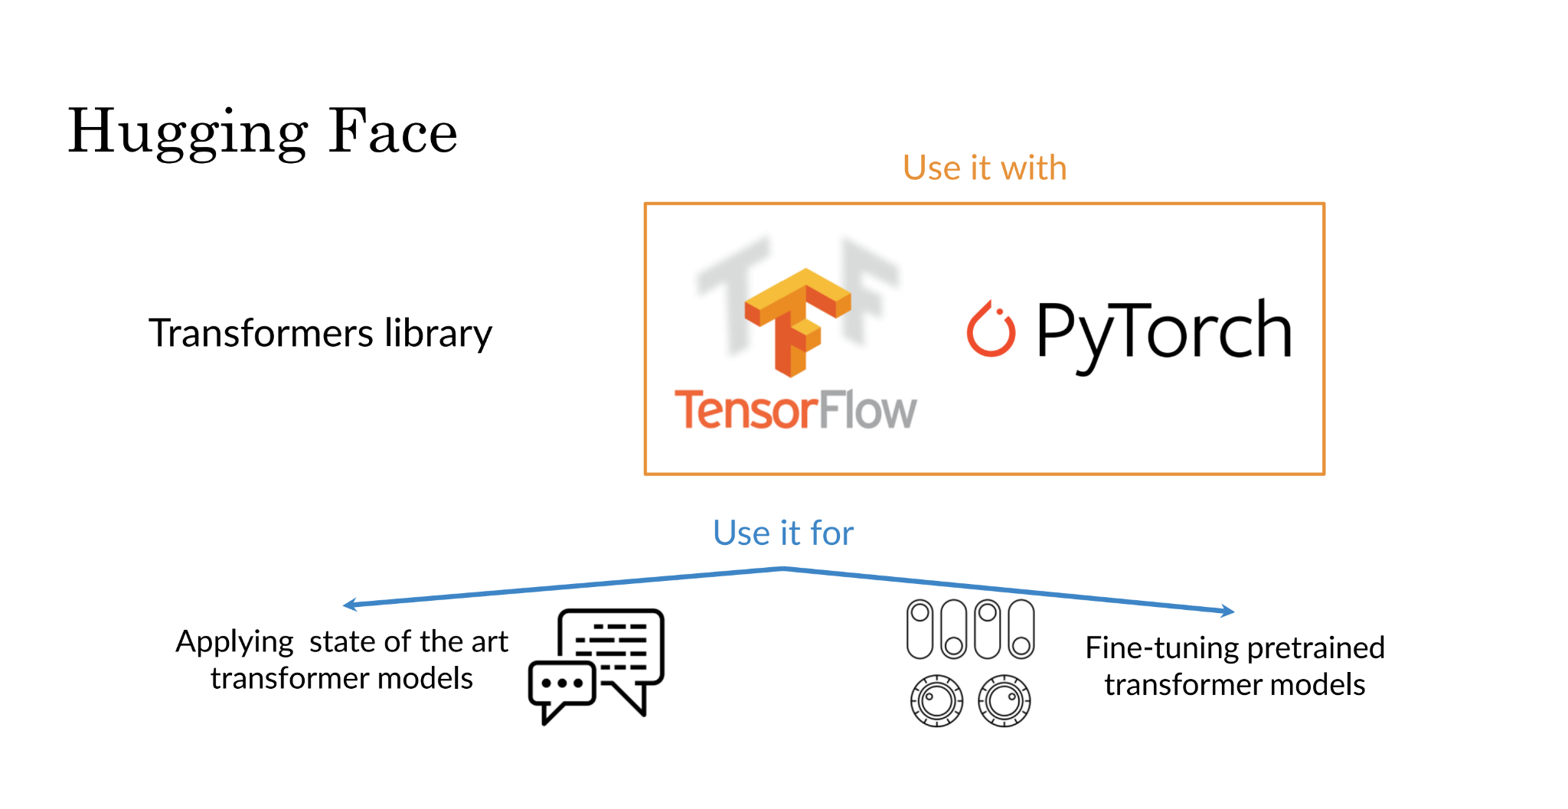

Slide 3
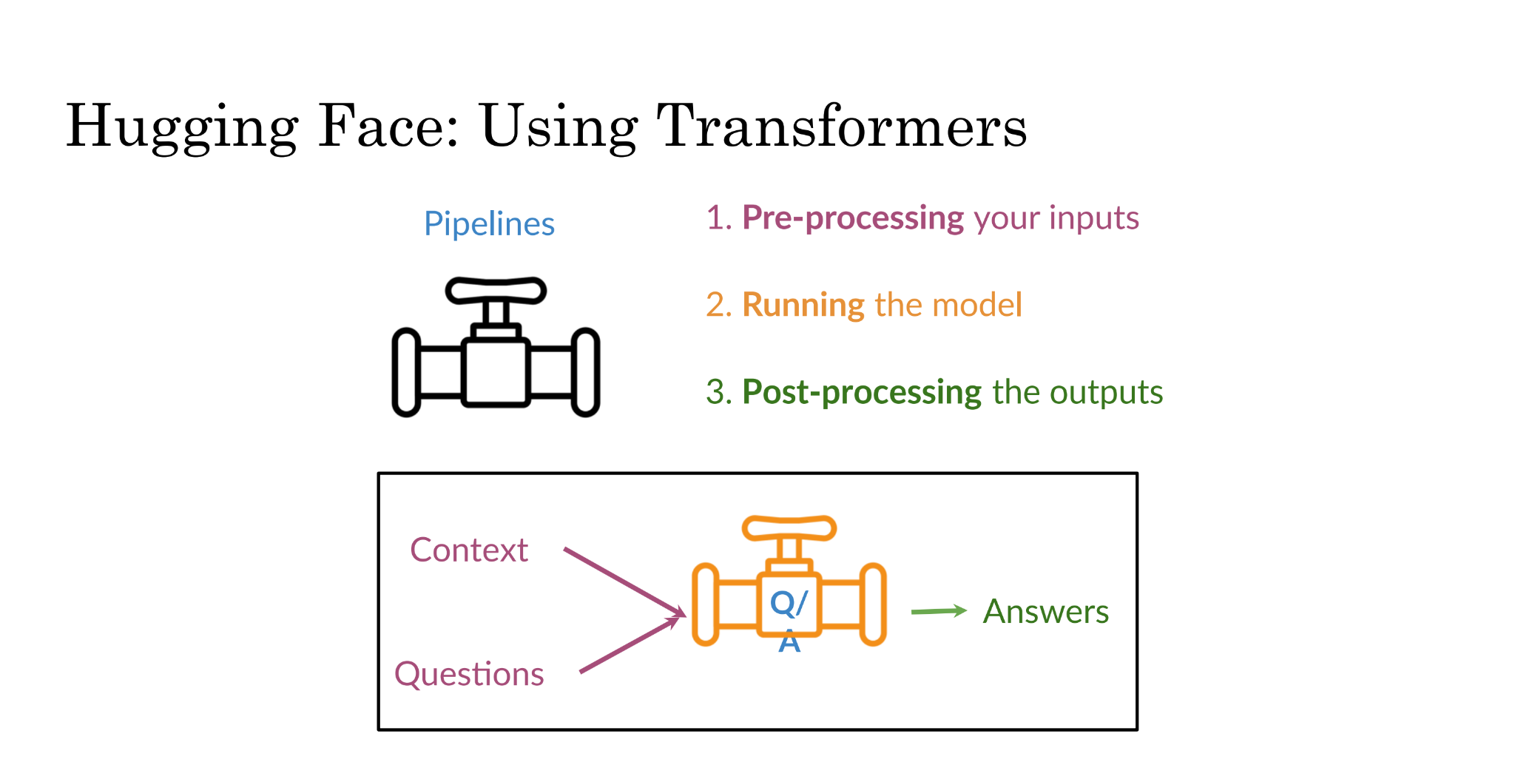

Slide 4
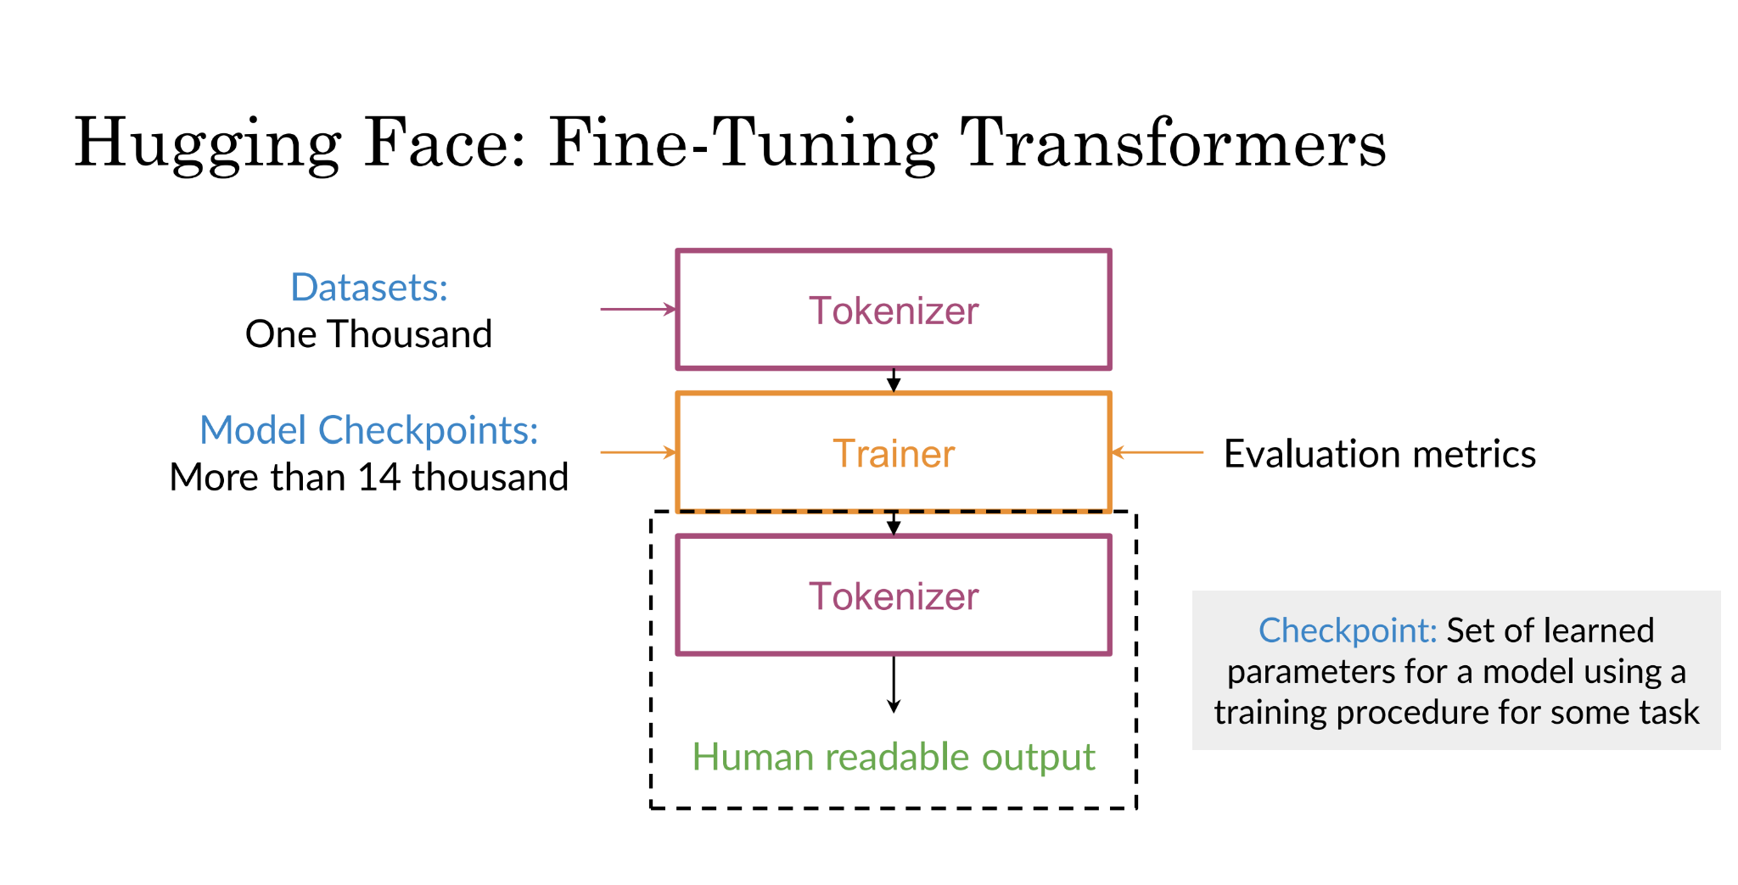

Slide 5
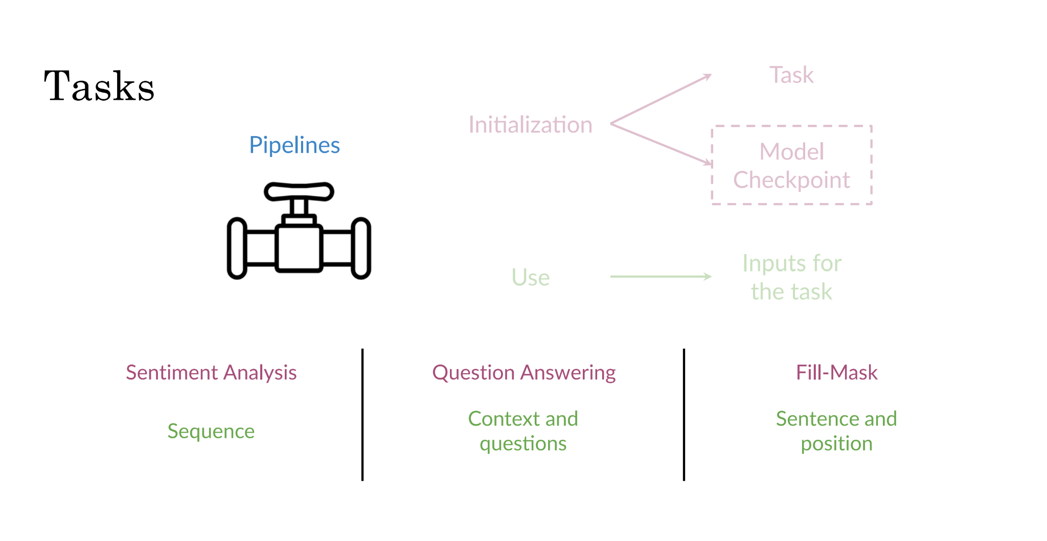

Slide 6
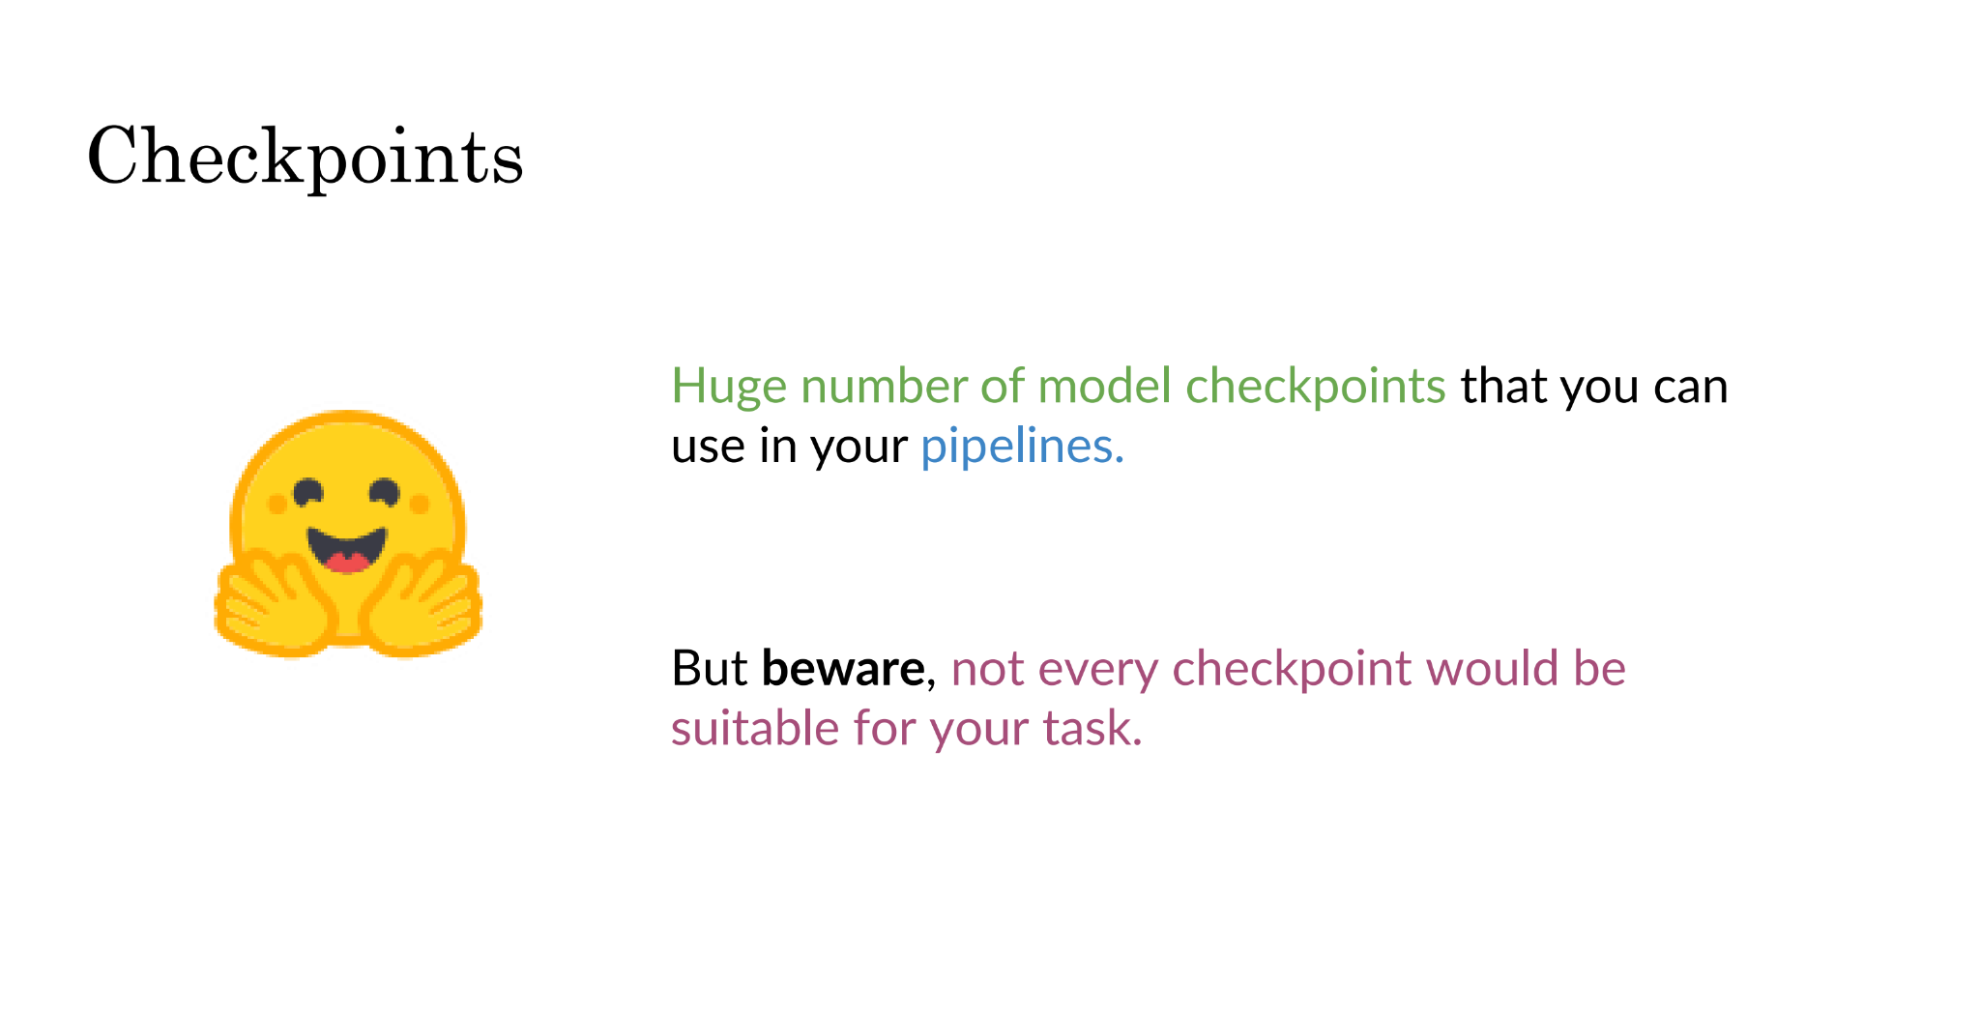

Slide 7
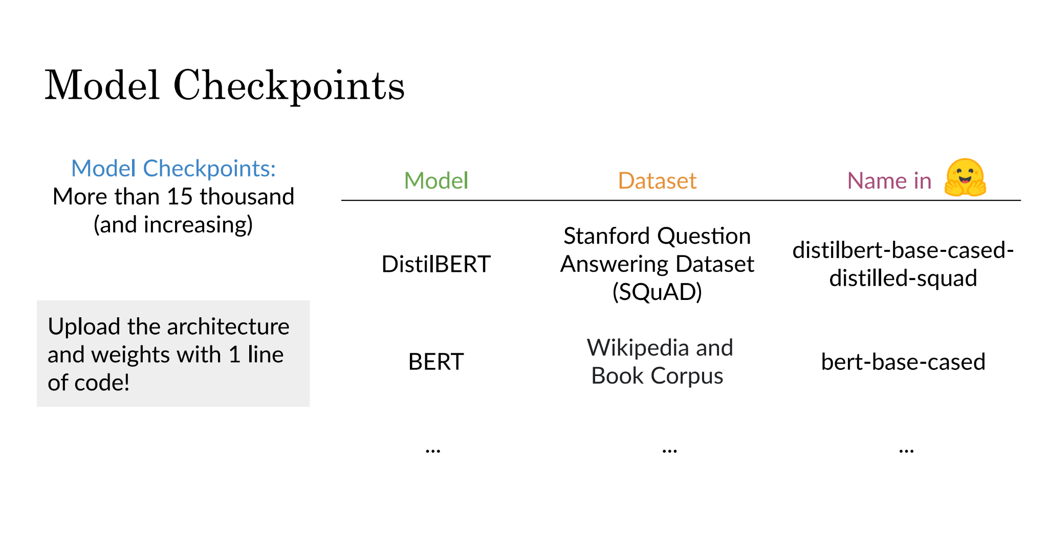

Slide 8
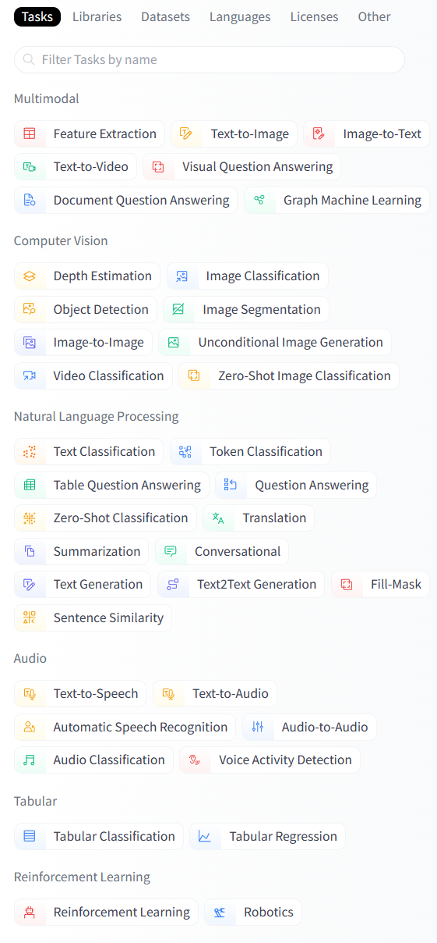
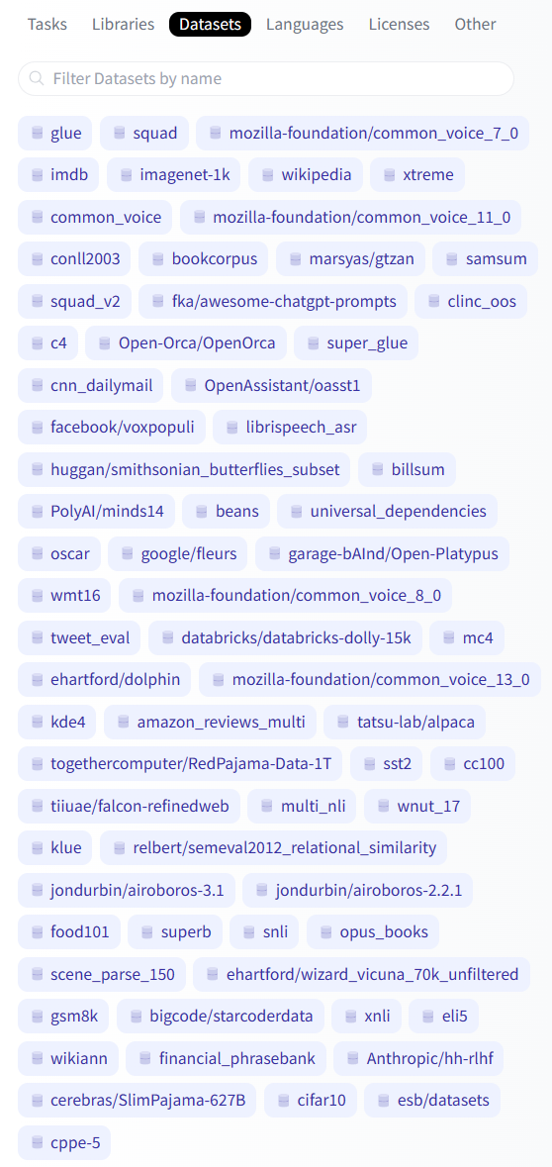
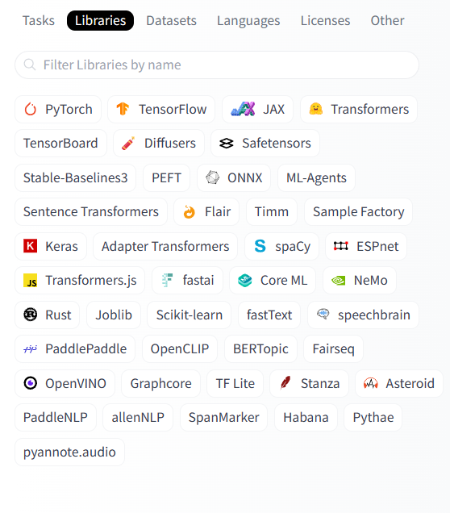
Model Card and Datasets

Slide 9
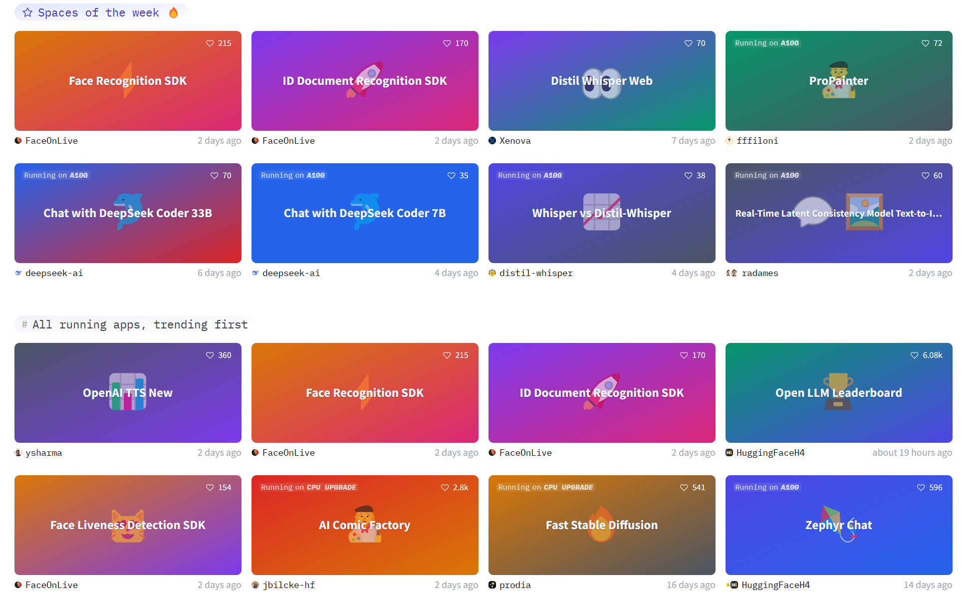
Hugging Spaces
Discover amazing ML apps made by the community!
Create new Space

Slide 10
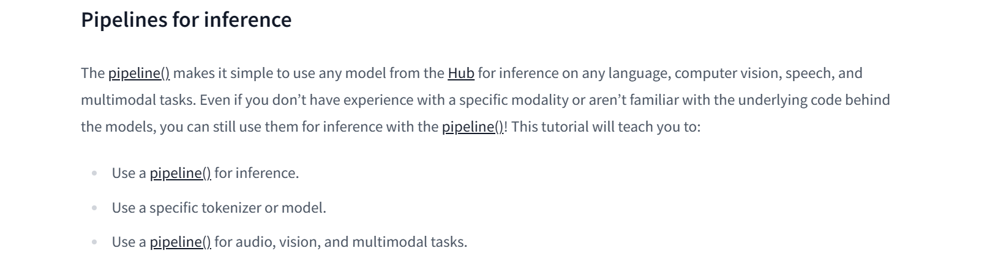
Hugging Spaces APIs
from transformers import pipeline
transcriber = pipeline(task="automatic-speech-recognition")
transcriber("https://huggingface.co/datasets/Narsil/asr_dummy/resolve/main/mlk.flac")
Output: {'text': 'I HAVE A DREAM BUT ONE DAY THIS NATION WILL RISE UP LIVE UP THE TRUE MEANING OF ITS TREES'}

Slide 11
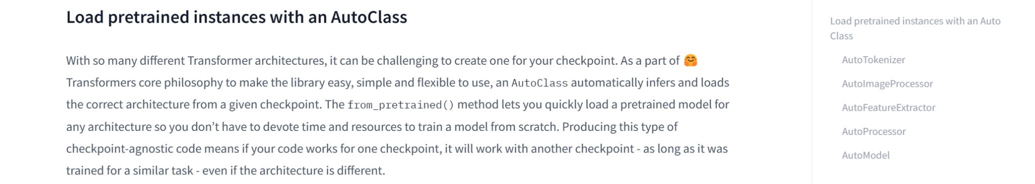
from transformers import AutoTokenizer
tokenizer = AutoTokenizer.from_pretrained("bert-base-uncased")
sequence = "In a hole in the ground there lived a hobbit."
print(tokenizer(sequence))
Output: {'input_ids': [101, 1999, 1037, 4920, 1999, 1996, 2598, 2045, 2973, 1037, 7570, 10322, 4183, 1012, 102],
'token_type_ids': [0, 0, 0, 0, 0, 0, 0, 0, 0, 0, 0, 0, 0, 0, 0], 'attention_mask': [1, 1, 1, 1, 1, 1, 1, 1, 1, 1, 1, 1, 1, 1, 1]}

Slide 12
from transformers import AutoImageProcessor
image_processor = AutoImageProcessor.from_pretrained("google/vit-base-patch16-224")
from transformers import AutoFeatureExtractor
feature_extractor = AutoFeatureExtractor.from_pretrained(
... "ehcalabres/wav2vec2-lg-xlsr-en-speech-emotion-recognition")
from transformers import AutoProcessor
processor = AutoProcessor.from_pretrained("microsoft/layoutlmv2-base-uncased")
from transformers import AutoModelForSequenceClassification
model = AutoModelForSequenceClassification.from_pretrained("distilbert-base-uncased")
from transformers import AutoModelForTokenClassification
model = AutoModelForTokenClassification.from_pretrained("distilbert-base-uncased")

